Slide 1

Section 3.6 Rational Functions
Lecture 1
Infinity and Such Things

Slide 2

Homework Submission to Canvas
Preview of section
Skim the section in text and write a short paragraph summary.
Give a bulleted list of all important definitions, theorems, and formulas without details.
Notes on video lectures
Take notes on everything written on slides including all details, worked examples, on-own activities, as well as your own thoughts and questions.
Try on-own activities first, then write down provided solution next to it for comparison.
Worked examples from the text
Write down the problem and attempt without looking at the solution.
Use the solution to write the best explanation you can.
Solutions to textbook exercises
Model approaches and explanations given in the video lectures and textbook examples.
Final reflection of section
List the key takeaways to remember as a bulleted list.

Slide 3
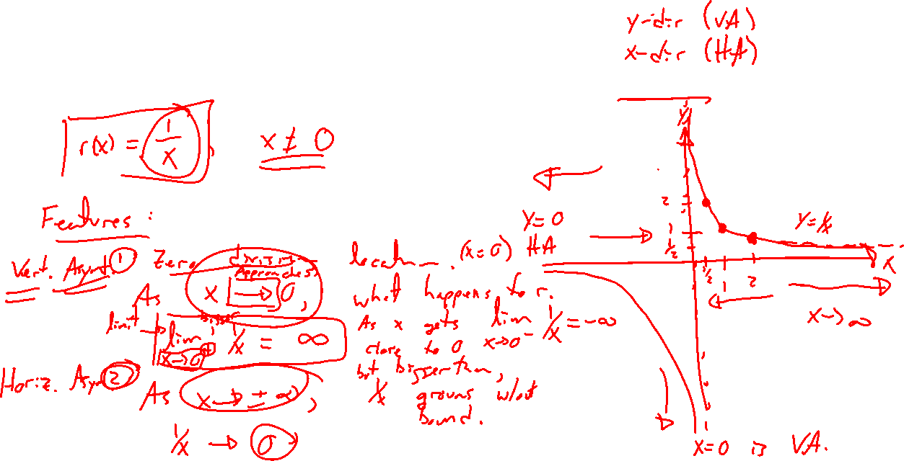
Example: Motivation and Infinity Twice
Notes:
Basic case: r(x) = 1/x
Reason out graph. Domain and range.
VAs and HAs.

Slide 4
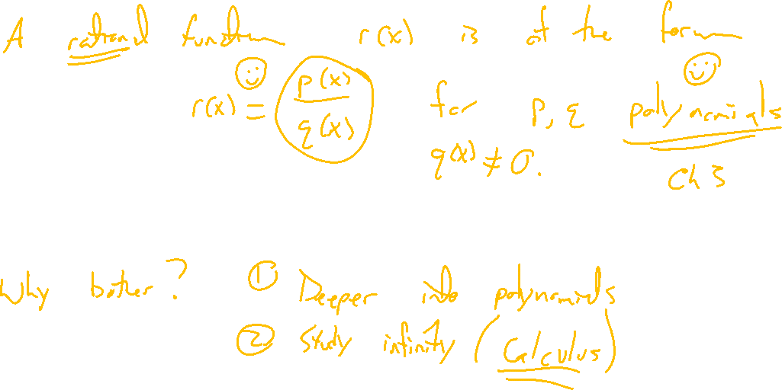
Definition: Rational Function
Notes:
R(x) = p(x)/q(x)
P,q polynomials
Need q(x) not zero.
Show up places, especially in math theory. Good setting to think about infinity.

Slide 5
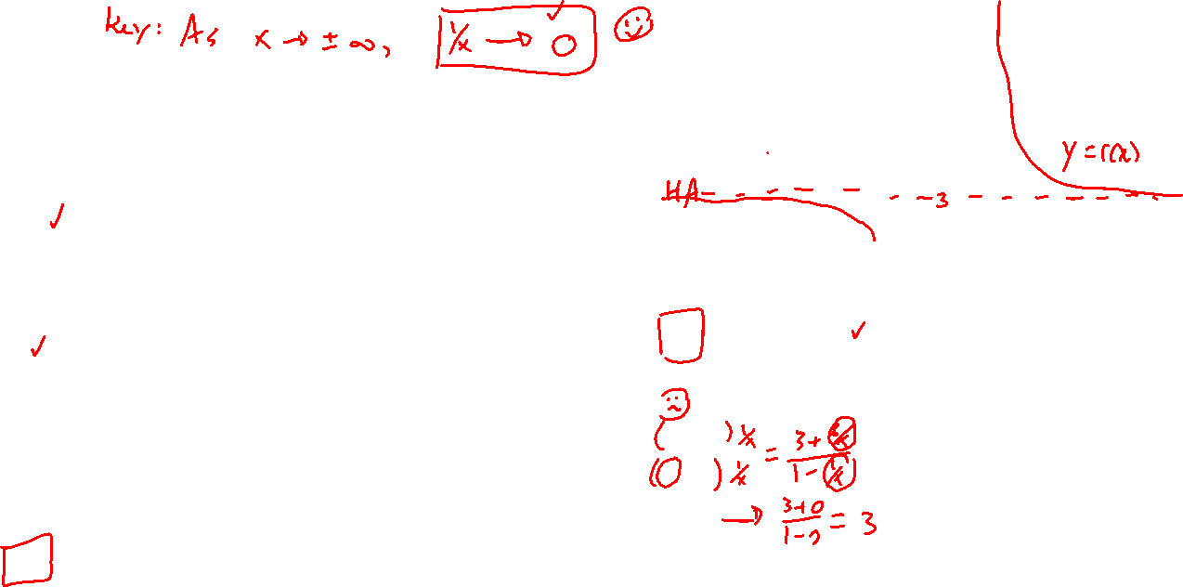
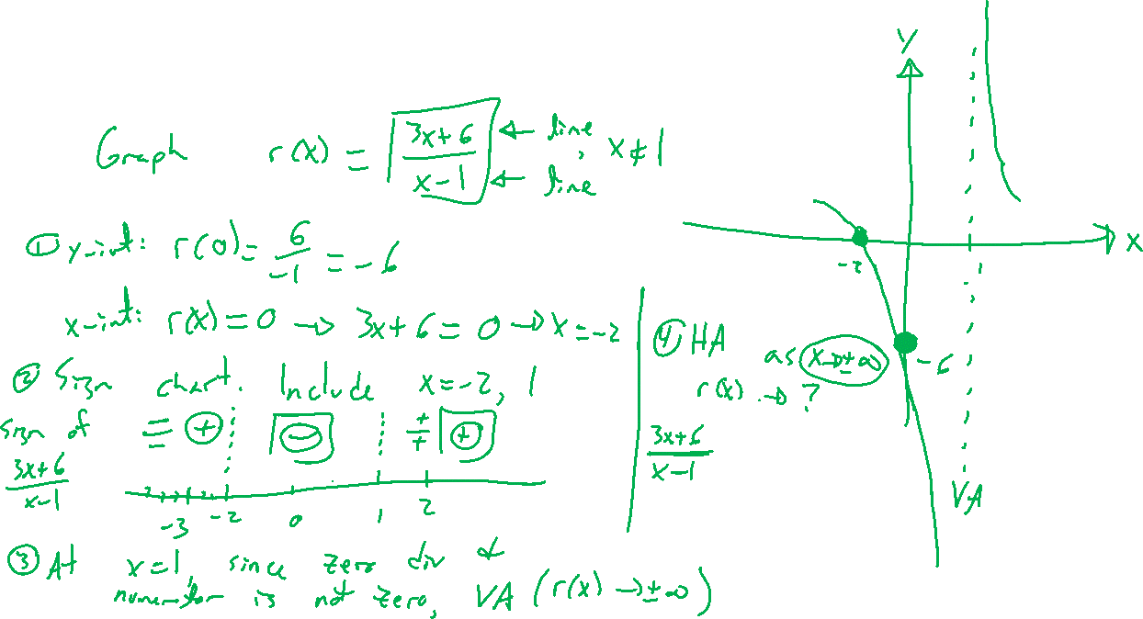
Example: Try on Own
Notes:
Graph r(x)=(3x+6)/(x-1)
Zeros, asymptotes, sign chart helps.
Check with Desmos
Think of end behavior by dividing by the highest order term. 1/x is easy to understand.

Slide 6
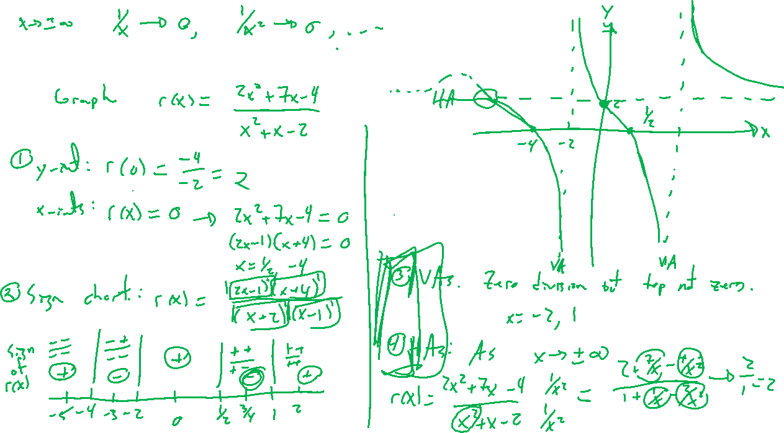
Example: Try on Own
Notes:
Same for r(x)=(2x^2+7x-4)/(x^2+x-2)

Slide 7
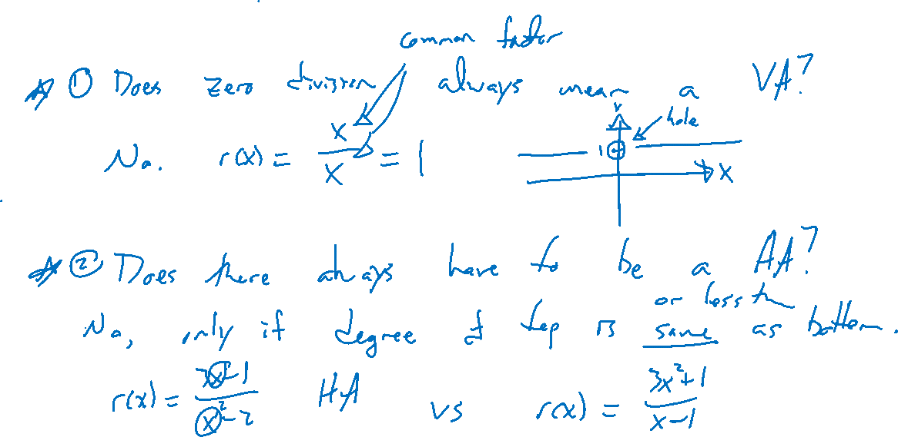
Other Situations
Notes:
Does there always have to be a VA? No can be a hole: x/x, (x^2-2)/(x+2)
Does there always have to be a HA? No degree doesn't have to match for p and q. Zero HA, slant asymp, etc

Slide 8

Textbook Examples and Exercises
Rework examples 3, 4, 5, 6, 8 in the text. Steps:
Write down a problem.
Close the book and attempt on own.
Check / correct your solution against the text solution.
If needed, rewrite the problem to be of the quality of the text solution.
Complete exercises 21, 27, 35, 45
Write solutions of the same quality as in lecture and text solutions.
Check your solution against the answer in the back of the book.

Slide 9

Homework Submission to Canvas
Preview of section
Skim the section in text and write a short paragraph summary.
Give a bulleted list of all important definitions, theorems, and formulas without details.
Notes on video lectures
Take notes on everything written on slides including all details, worked examples, on-own activities, as well as your own thoughts and questions.
Try on-own activities first, then write down provided solution next to it for comparison.
Worked examples from the text
Write down the problem and attempt without looking at the solution.
Use the solution to write the best explanation you can.
Solutions to textbook exercises
Model approaches and explanations given in the video lectures and textbook examples.
Final reflection of section
List the key takeaways to remember as a bulleted list.

